Slide 1
Chest imaging
Lecture four
Dr. Marwa Majid Aladhab

Slide 2
Objectives
Pleural disorders
Special issues: - Tuberculosis
- Emphysema
- Bronchiectasis
- Lung cancer

Slide 3
Pleural disorders
Include:
accumulation of fluid in the pleural spaces (pleural effusion).
air leaks (pneumothorax and pneumomediastinum).
pleural soft tissue thickening and plaque formation.

Slide 4
Pleural effusion
Refers to accumulation of fluid in the pleural space, between the visceral and parietal pleural layers.
The radiographic appearances of pleural effusion are generally the same regardless of the nature of the fluid, which may include transudate, exudate, blood, pus (empyema) or lymph (chylothorax).
Signs of pleural effusion on erect CXR:
• Homogeneous dense opacity at the base of the lung
• Concave upper surface higher laterally than medially, producing a meniscus
• Small pleural effusions produce blunting of the normal sharp angle between the lateral curve of the diaphragm and the inner chest wall, referred to as blunting of the costophrenic angle
• Large pleural effusions displace the mediastinum towards the contralateral side.
Notes:
The lateral view is more sensitive to the presence of small pleural effusions than the PA view. It is estimated that about 300 mL of fluid is required to show costophrenic angle blunting on the PA, whereas only 100 mL is required to produce this sign (posteriorly) on the lateral view.

Slide 5
Causes of pleural effusion
• Cardiac failure: : bilateral pleural effusions, right usually larger than left
• Malignancy: bronchogenic carcinoma, metastatic, mesothelioma
• Infection: bacterial pneumonia, TB, mycoplasma, empyema, subphrenic abscess
• Pulmonary embolus with infarct
• Pancreatitis: effusion is usually left-sided
• Trauma: associated with rib fractures
• Connective tissue disorders: rheumatoid arthritis, SLE
• Liver failure
• Renal failure
• Meig’s syndrome: associated with ovarian tumor

Slide 7
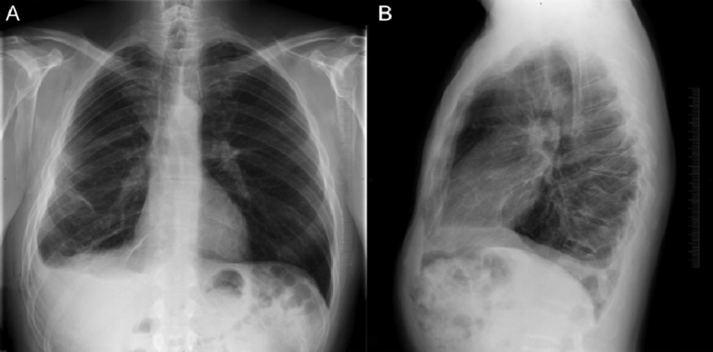

Slide 8
Signs of pleural fluid on supine CXR:
include opacity over the lung apex (pleural cap) and increased opacity of the hemithorax, through which lung structures can still be seen.
There is often loss of definition of the hemidiaphragm and blunting of the costophrenic angle.
Notes:
Differentiated from consolidation by air bronchogram and visualization of lung structures

Slide 9
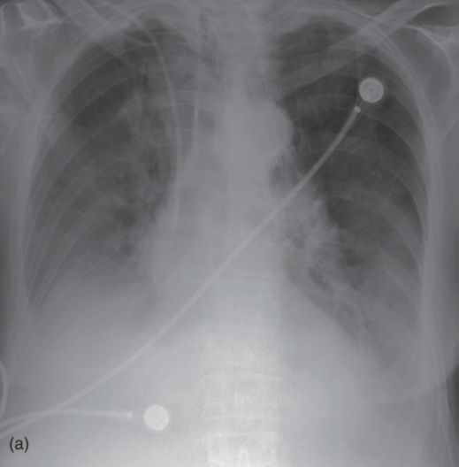
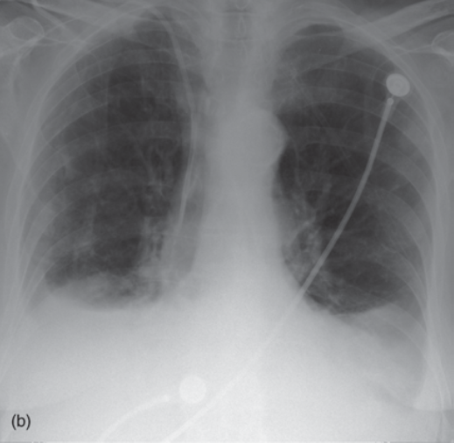

Slide 10
Pneumothorax
refers to accumulation of air in the pleural space, between the visceral and parietal pleural layers.
Signs on CXR: lung edge outlined by air in the pleural space
Notes:
Expiratory scan more sensetive to small pneumothorax

Slide 11
Tension pneumothorax
Occurs with continued air leak from the lung into the pleural space.
This results in increased pressure in the pleural space with expansion of the hemithorax and further compression and collapse of the lung.
CXR signs of tension pneumothorax :
Marked collapse and distortion of the lung
Increased volume of hemithorax:
• Displacement of the mediastinum to the contralateral side
• Depressed diaphragm
• Increased space between the ribs.

Slide 12
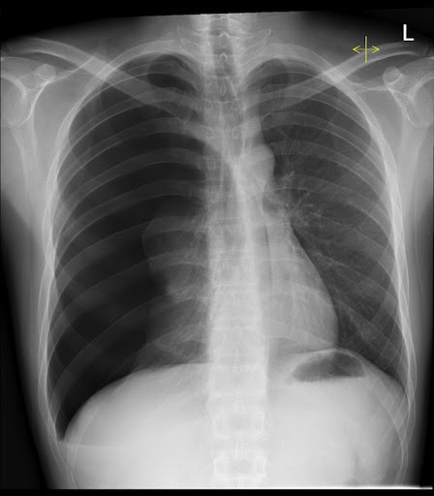

Slide 13
Signs of pneumothorax on a supine CXR:
• Mediastinal structures including heart border, inferior vena cava (IVC), SVC are sharply
outlined by adjacent free pleural air
• Upper abdomen appears lucent due to overlying air
• Deep lateral costophrenic angle.
Notes:
Supine AP CXR may have to be performed in ICU patients or following severe trauma. Pleural air lays anteromedially and beneath the lung so that the usual appearance of a pneumothorax as described for an erect PA film is not seen.

Slide 14
Causes of pneumothorax
• Spontaneous: tall, thin males, smokers
• Iatrogenic: percutaneous lung biopsy, complication of ventilation, central venous pressure (CVP) line or cardiac pacemaker insertion
• Trauma: associated with rib fractures
• Malignancy: high incidence with osteogenic sarcoma metastases
• Emphysema
• Honeycomb lung
• Lymphangiomyomatosis (LAM): interstitial disease of young women
• Cystic fibrosis.

Slide 15
Pneumomediastinum
Pneumomediastinum refers to air leak into the soft tissues of the mediastinum.
Causes of pneumomediastinum:
• Spontaneous: following severe coughing or strenuous exercise
• Asthma
• Foreign body aspiration in neonates
• Chest trauma
• Oesophageal perforation: tumor, severe vomiting and endoscopy.

Slide 16
Radiographic signs of pneumomediastinum are due to air outlining the normal mediastinal structures:
• A strip of air outlining the left side of the mediastinum
• Air around the aorta, pulmonary arteries and pericardium
• Subcutaneous air extending upwards into the soft tissues of the neck

Slide 17
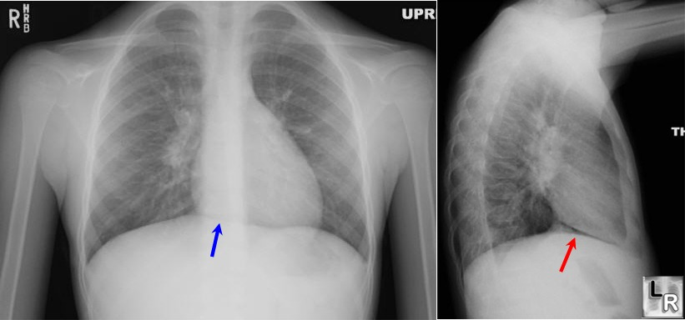
Notes:
Pneumomediastinum. A thin layer of air is seen parallel to the left mediastinal margin (white arrows). Air is also seen tracking into the soft tissues of the neck (blackarrow).

Slide 18
Pleural thickening
Pleural thickening or pleural plaque formation may occur in a variety of circumstances
• Secondary to trauma
• Following empyema
• TB
• Asbestos exposure
• Mesothelioma
• Pancoast tumor: Primary apical lung neoplasm, Rib destruction with irregular pleural thickening
• Pleural metastases: often obscured by associated pleural effusion.
Notes:
Secondary to trauma: Associated with healed rib fractures • Dense layer of soft tissue, often calcified
Following empyema • More common over the lung bases • Often calcified

Slide 19
Radiographic appearances
• Blunting of costophrenic angles, mimicking pleural effusion
• Soft tissue thickening over the lungs, including the lung apices
• Calcification of the pleural surfaces due to previous pleural hemorrhage or infection
• Pleural plaques: • Convex, pleural-based opacities when seen
in profile • Less well-defined opacities when not in profile
• May be calcified, especially with a history of exposure to asbestos.

Slide 21
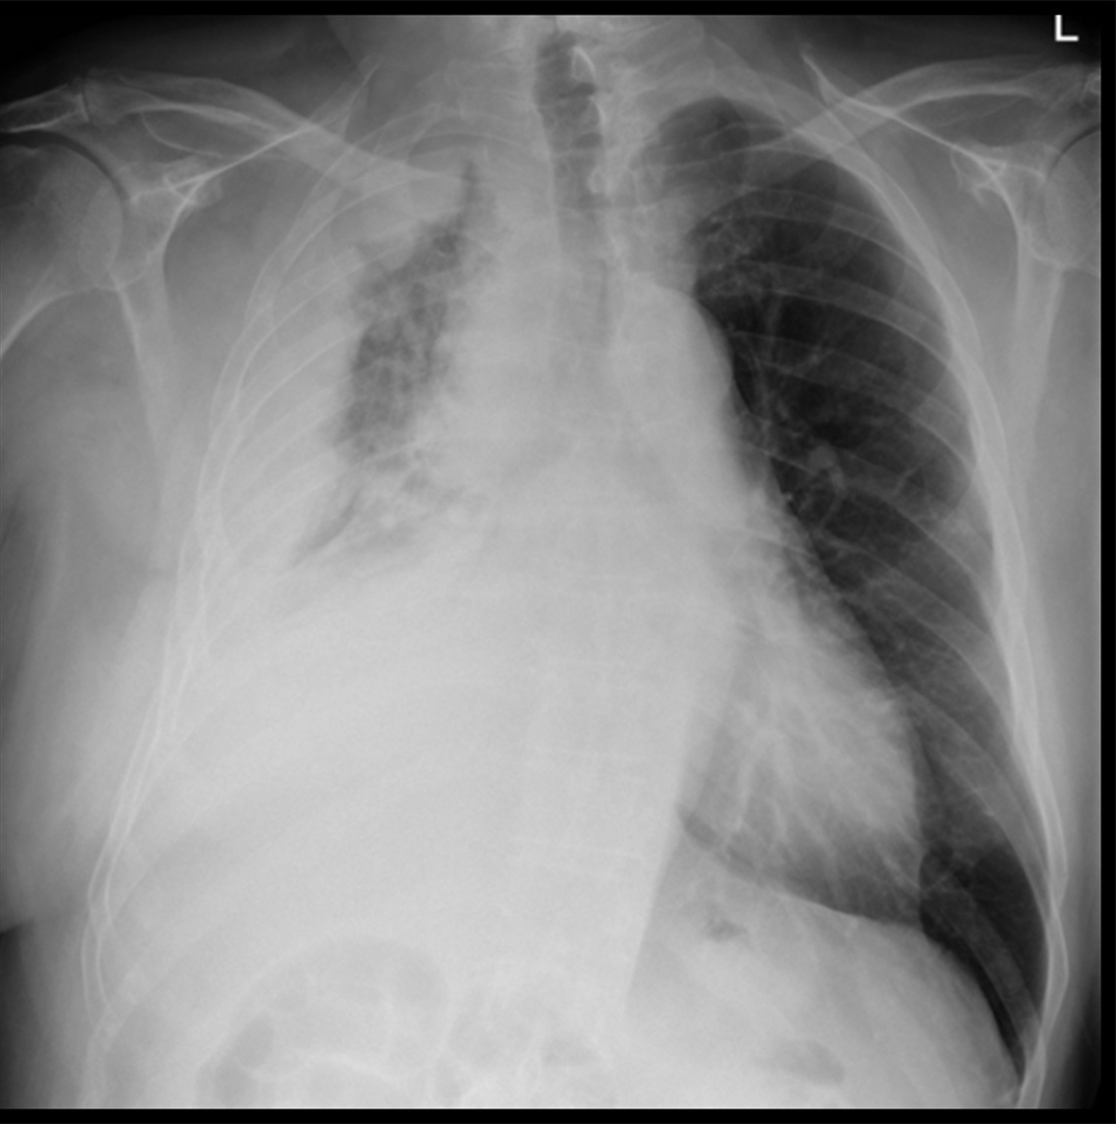
Mesothelioma
• Diffuse or localized pleural mass
• Rib destruction uncommon
• Large pleural effusions common
• Pleural plaques elsewhere in 50 per cent

Slide 22
Special issues

Slide 23
Tuberculosis (pulmonary manifestation)
Primary T.B
Primary TB is usually asymptomatic.
Primary infection can be anywhere in the lung in children whereas there is a predilection for the upper or lower zone in adults The healed pulmonary lesion of primary TB may be seen on CXR as a small, calcified peripheral pulmonary nodule with calcified hilar lymph node.
Notes:
the primary infection is usually asymptomatic (the majority of cases), although a small number go on to have symptomatic hematological dissemination which may result in miliary tuberculosis. Only in 5% of patients, usually those with impaired immunity, go on to have progressive primary tuberculosis.

Slide 24
Post-primary pulmonary T.B (reactivation TB)
has a predilection for the apical and posterior segments of the upper lobes, plus the apical segments of the lower lobes.

Slide 25
CXR appearances
Variable CXR appearances may include:
ill-defined areas of alveolar consolidation and thick-walled, irregular cavities.
Aspergilloma, tuberculous empyema and bronchopleural fistula may complicate cavitation.
Endobronchial spread along nearby airways is a relatively common finding, resulting in relatively well-defined 2-4 mm nodules or branching lesions (tree-in-bud sign) on CT
Hilar nodal enlargement is seen in only approximately a third of cases
Lobar consolidation, tuberculoma formation, and miliary TB are also recognized patterns of post-primary TB but are less common.
Broncholith
Tuberculous pleural effusion
Fibrosis: may cause volume loss in the upper lobes.
Notes:
is one of the most common forms of extrapulmonary tuberculosis which usually occurs in the acute stages, diffuse pleural thickening and adhesions often with calcification occurs in chronic cases

Slide 26
Tuberculoma: account for only 5% of cases of post-primary TB and appear as a well-defined rounded mass typically located in the upper lobes. They are usually single (80%) and can measure up to 4 cm in size. Small satellite lesions are seen in most cases . In 20-30% of cases, superimposed cavitation may develop.
Tracheal and bronchial involvement:
Insolated tracheal infection by tuberculosis is rare but reported and typically results in irregular circumferential mural thickening. It is usually the result of a contiguous inflammation from adjacent nodal involvement

Slide 27
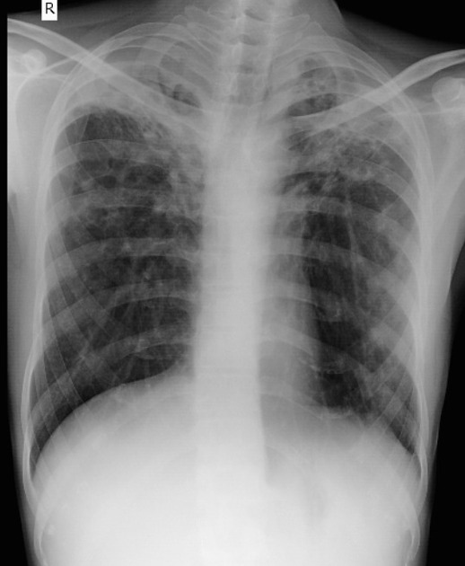
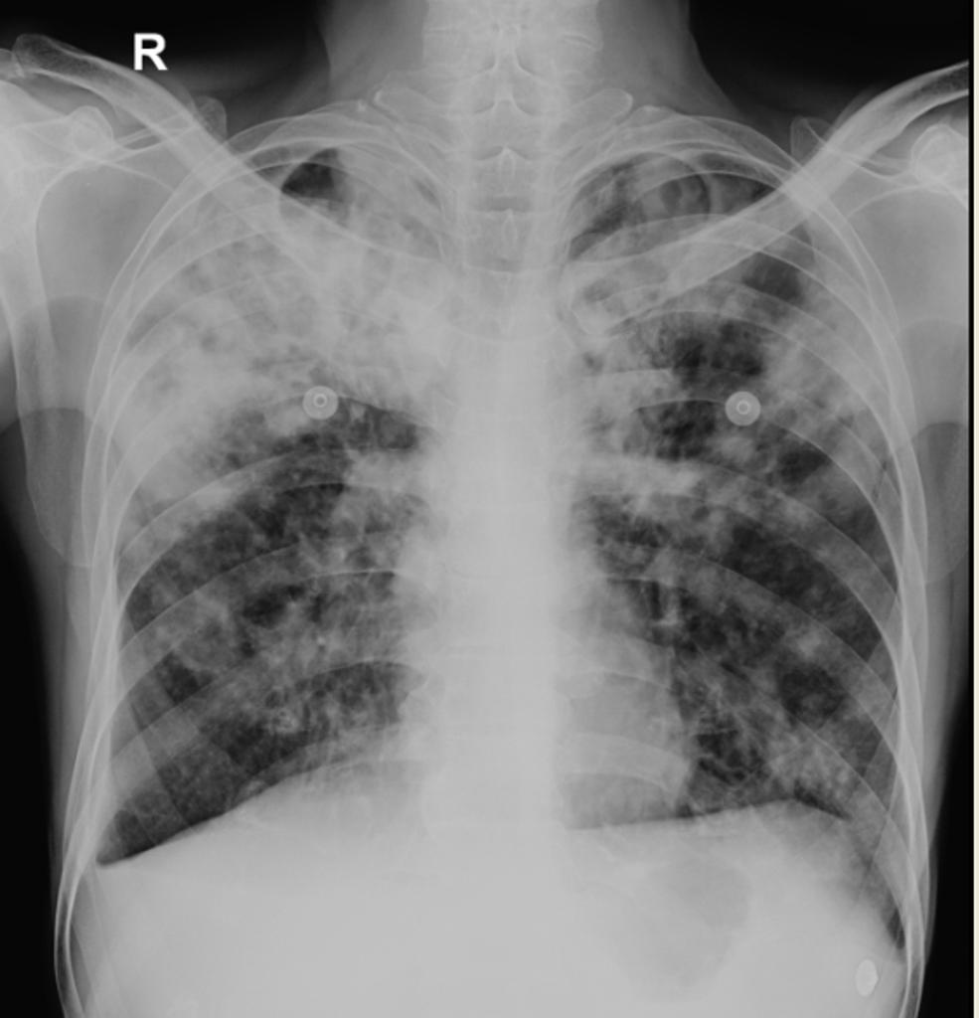
Notes:
Diffuse bilateral, largely upper lobe, fluffy consolidation and pulmonary infiltrates. Suggestion of small area of cavitation at the left lung apex.

Slide 28
Broncholith
A broncholith is a relatively uncommon presentation which is due to erosion of a calcified lymph node into a bronchus, resulting in calcified material entering the lumen. Rarely this material can be coughed up (known as lithoptysis)

Slide 29
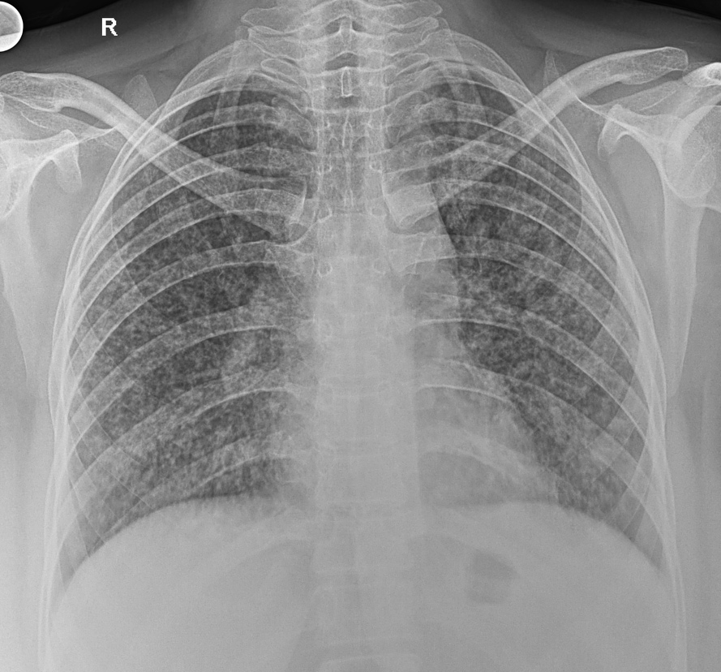
Miliary T.B
Miliary TB occurs due to haematogenous dissemination, which may occur at any time following primary infection.
On CXR, miliary TB appears as tiny densities of approximately 2 mm diameter spread evenly through both lungs.
Notes:
uncommon but carries a poor prognosis. It represents hematogenous dissemination of an uncontrolled tuberculous infection. It is seen both in primary and post-primary tuberculosis.

Slide 30
Emphysema
Refers to enlarged airspaces secondary to destruction of the alveolar walls.
Centrilobular emphysema is the most common form; it occurs in smokers and predominantly affects the upper lobes.
Panlobular emphysema is seen in association with alpha-1 antitrypsin deficiency; it tends to predominantly affect the lower lobes.
High resolution CT of the lungs (HRCT) may be used to assess accurately the severity and distribution of emphysema, quantitate the percentage of residual healthy lung, and identify associated findings such as bronchogenic carcinoma.

Slide 31
CXR signs of emphysema
• Overexpanded lungs: • Flattening of the diaphragms, best seen on lateral CXR
• Diaphragms lie below anterior end of sixth rib on frontal view
• Increased retrosternal airspace on lateral film
• Decreased vascular markings in lung fields
• Increased AP diameter of the chest, with in some cases kyphosis and anterior bowing of the
sternum
• Bulla formation: bullae are seen as thin-walled air-containing cavities
• Pulmonary arterial hypertension: prominent main pulmonary arteries.
Notes:
Beware incorrect diagnosis of pulmonary overexpansion in a young, athletic patient capable of a large inspiration

Slide 33
Bronchiectasis
Refers to permanent dilatation of the airways secondary to chronic inflammation or infection. It is the common pathological response of bronchi to a variety of congenital and acquired conditions.
Etiology
1- post-infectious conditions:
  tuberculosis
  bacterial pneumonia
  measles

Slide 34
2- congenital conditions
  cystic fibrosis (up to 50% of cases)
  primary ciliary dyskinesia (Kartagener syndrome)
  primary immunodeficiencies
  alpha-1-antitrypsin deficiency
3- other
  airway obstruction (foreign body/malignancy)
  traction bronchiectasis (pulmonary fibrosis)
  associated illnesses - COPD, IBD, rheumatoid arthritis, SLE
4- idiopathic

Slide 35
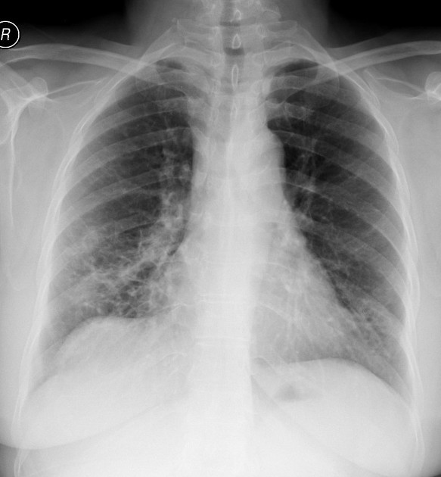
Imaging investigations
1- chest x-ray:
usually insufficient in the diagnosis and management of bronchiectasis.
May be normal or may show dilated bronchi with thickened walls (tram-track sign).
An air-fluid level may be seen in severe cystic bronchiectasis
Notes:
sputum culture (esp. during exacerbation), pulmonary function tests (reduced FEV1) specific tests to investigate cause e.g. sweat sodium measurement (CF) or immunoglobulins

Slide 36
2- high-resolution CT:
High-resolution CT is the gold standard for diagnosis.
Provides a better visualization of the classical airway dilatation and bronchial wall thickening (tram-track) in bronchiectasis.
Enlarged airways display a signet-ring sign in cross-section with their accompanying pulmonary artery.
Cysts may also be visualized.

Slide 37
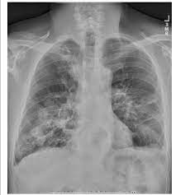
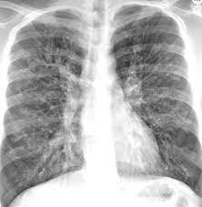
Notes:
Left image: Chest x-ray (PA) revealing bilateral cystic bronchiectasis, scattered areas of scarring, and round lesions in the cavities compatible with mycetoma

Slide 38
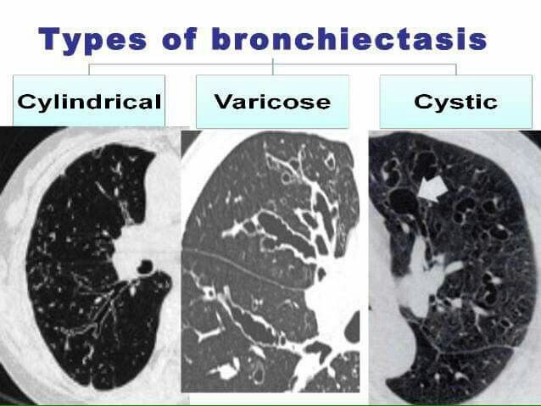

Slide 39
Lung cancer
Is classified into small cell lung cancer (SCLC) and non-small cell lung cancer (NSCLC).
Most bronchogenic carcinomas are initially diagnosed on CXR.
CXR may be performed for investigation of a specific symptom, such as haemoptysis or weight loss in a smoker. Alternatively, bronchogenic carcinoma may be an incidental finding on a CXR performed for other reasons, such as pre-anaesthetic or as part of a routine medical check-up.
CT is the imaging modality of choice for the staging of bronchogenic carcinoma.

Slide 40
Radiographic appearance
The usual appearance of a bronchogenic carcinoma on CXR is a pulmonary mass
Complications of bronchogenic carcinoma that may produce a more complex appearance on CXR include:
• Segmental/lobar collapse • Persistent areas of consolidation
• Hilar lymphadenopathy • Mediastinal lymphadenopathy
• Pleural effusion • Metastases: lungs, bones.
• Invasion of adjacent structures: mediastinum, chest wall

Slide 41
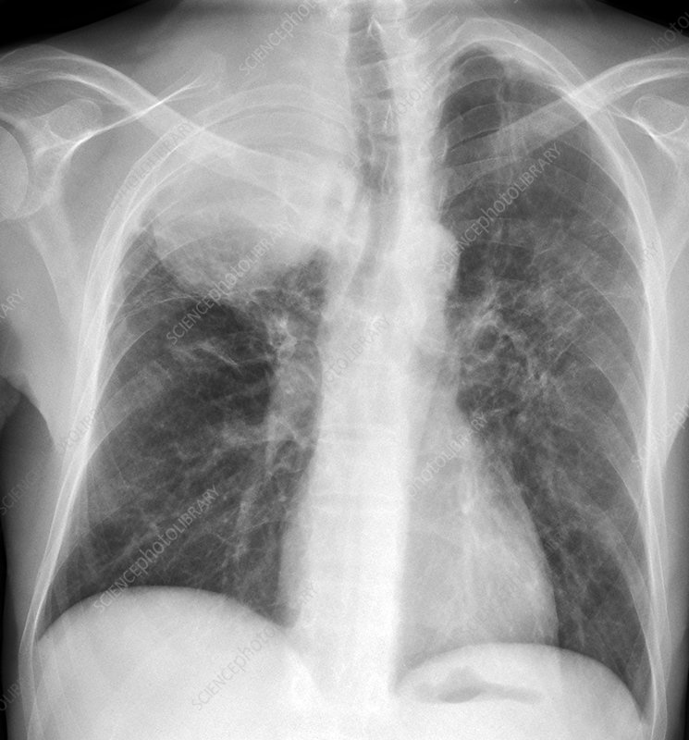

Slide 42
Any ???

Slide 43
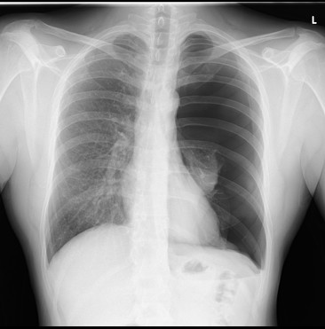

Slide 44
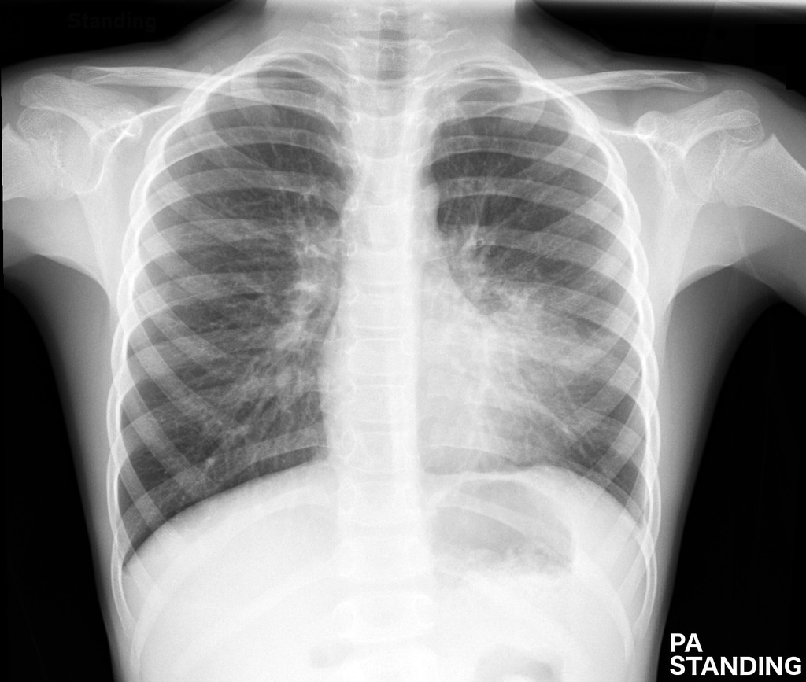

Slide 46
